Slide 1


Ensuring Growth for all Students Using MAP
Courtney Baker
Eddie Thompson

Slide 2
Objective
To leave with a better understanding of MAP data reports, see what’s new in MAP this year, and make more informed decisions in grouping our kids for small groups/intervention to ensure growth.

Slide 3
Is the data reliable?
MAP Norms (Benchmarks)
-The most recent norms are from 2015. They were based on a 3 year study which they explain in a user friendly 430 page document on their website. I only read the 4th grade Reading section, but my takeaway was that its intended use was for typical students, and of course that there’s always room for error (standard error).
- Our individual MAP reports are calculated taking into consideration the weeks between testing, but norms were calculated assuming we instruct for 4 weeks before the fall test, 20 weeks before Winter, and 32 before Spring.
Notes:
https://solutions.nwea.org/research/2015-map-norms-for-student-and-school-achievement-status-and-growth

Slide 4
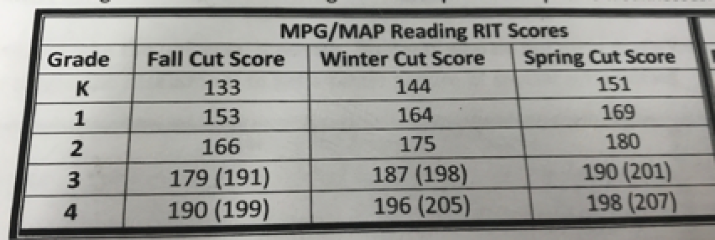
Benchmarks vs. Cut Scores
--The NWEA norms differ from the Fairfield “cut scores”.
-
-
-District cut scores are established to identify students that might benefit from the RTI process.
Notes:
https://solutions.nwea.org/research/2015-map-norms-for-student-and-school-achievement-status-and-growth

Slide 5
Why are we still talking about MAP?
New in 2018
-Many reports in MAP can be run by “Projected Proficiency”, where students are grouped by state test categories (limited, basic, proficient, etc.).
-Student “Quick Search” – Allows data to be displayed for individual students
-MAP test scores are to be declared “invalid” for students who were guessing on 30% or more of their test.
-New tools are now available to assist students during test sessions (such as answer elimination, zooming, and a notepad) to more closely mirror the state tests.
Notes:
http://info.nwea.org/201808-Partner-Update-MAP-Growth.html

Slide 6
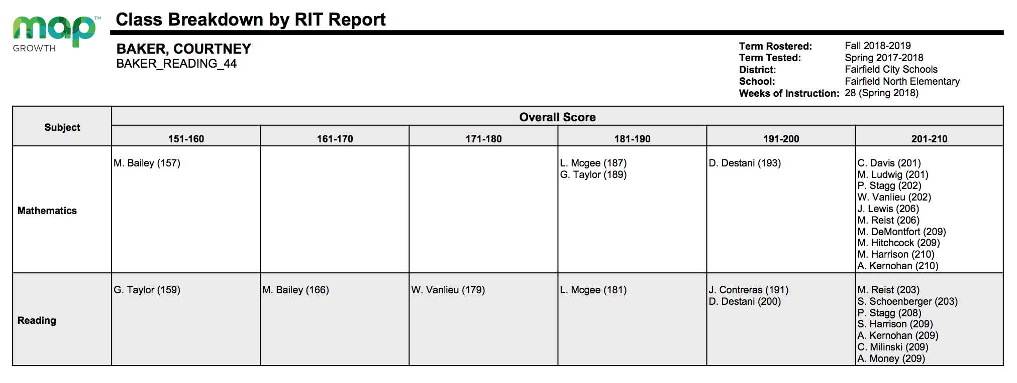
Projected Proficiency

Slide 7
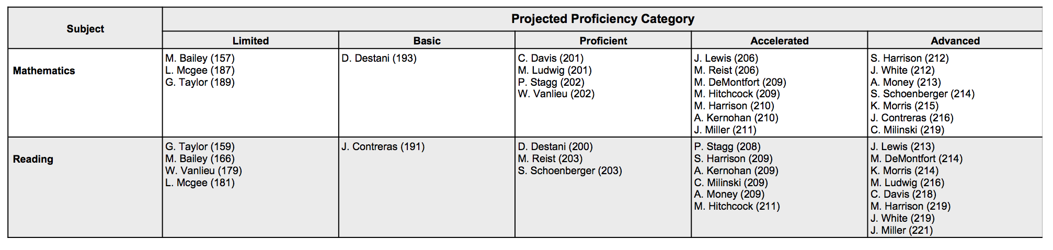
Projected Proficiency

Slide 8
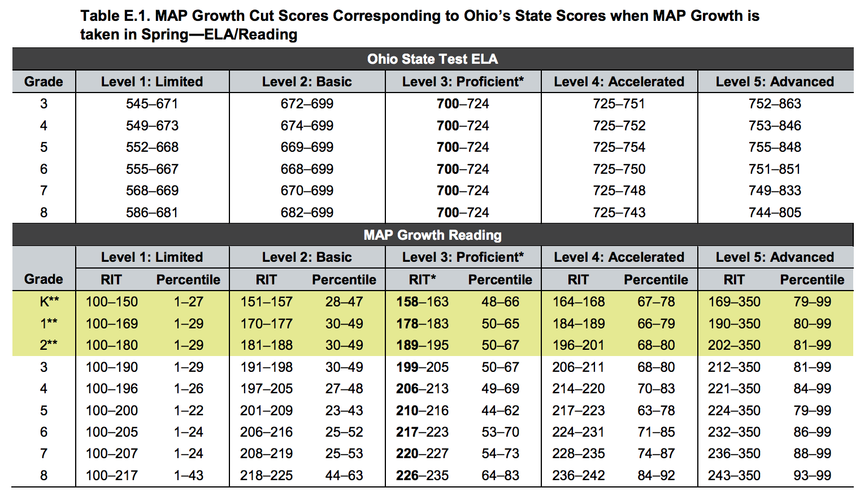
Projected Proficiency - Reading
Notes:
https://www.nwea.org/content/uploads/2018/08/Ohio-MAP-Growth-Linking-Study-Aug-2018.pdf

Slide 9
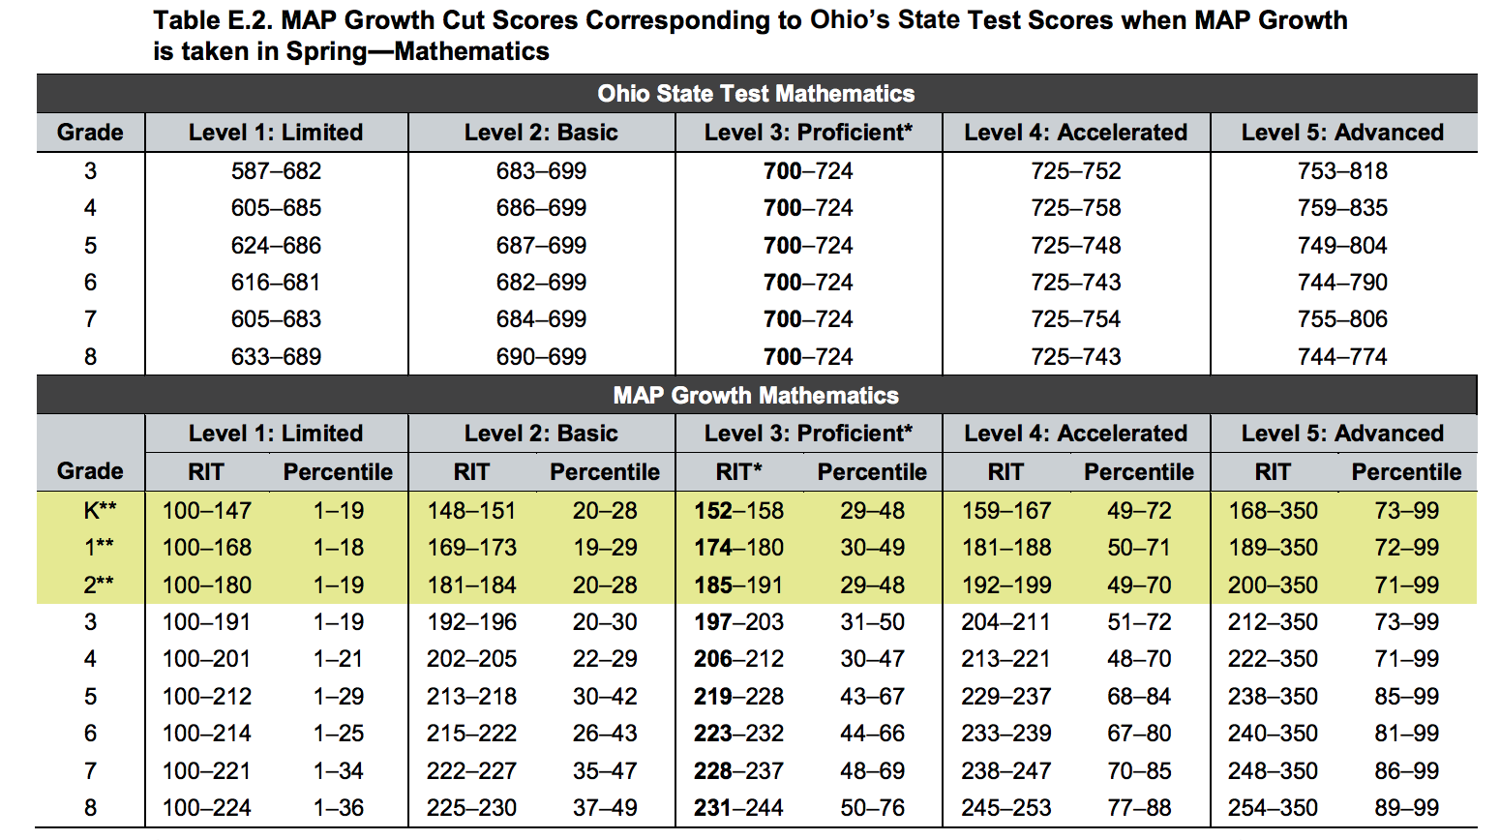
Projected Proficiency - Math
Notes:
https://www.nwea.org/content/uploads/2018/08/Ohio-MAP-Growth-Linking-Study-Aug-2018.pdf

Slide 10
Best Reports For:

Slide 11

TBT Meetings
-Class Report – Summary of class standings, average scores, etc.
-Class Breakdown – Math & Reading on one page. Everyone’s score in one place.
-Achievement

Slide 12
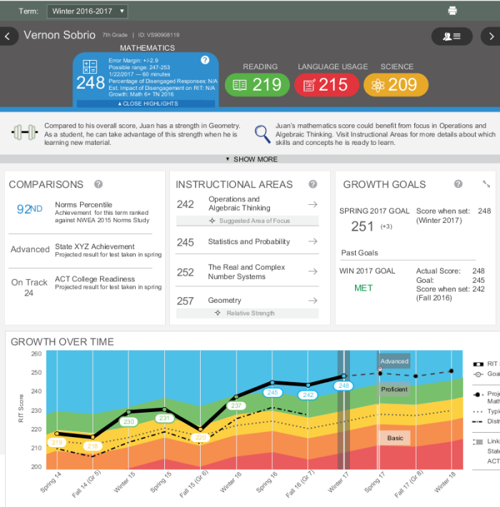
Student Goal Setting
-Student Profile – Allows you to set goals directly on a student’s profile, while viewing previous data points.

Slide 13
Conferences
-Student Quick Search – Allows you easily display a student’s progress during a parent conference or the information can be printed and distributed to parents to review at home.
-Student Profile – Interactive. Easy to read.
-Student Progress Report – Sent home after each testing session but our parent feedback suggests that many families are uninformed on how to interpret the results. The bar graph displaying the district average, NWEA norm, and individual scores seem to be much more user friendly for our families to understand.

Slide 14
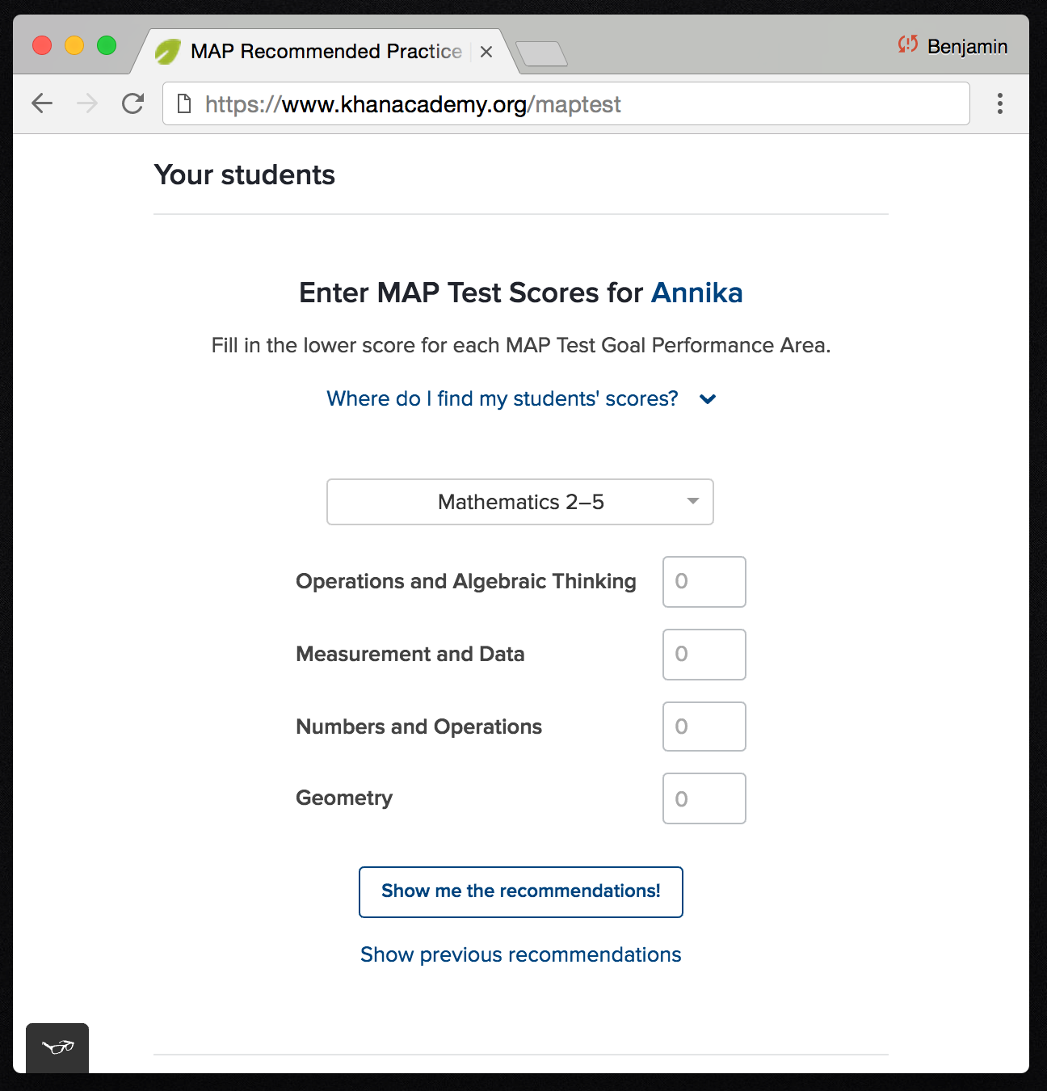
Math Homework (2-5)
-Differentiated online MATH homework by student MAP score:
https://www.khanacademy.org/mappers
Notes:
http://info.nwea.org/201808-Partner-Update-MAP-Growth.html

Slide 15
SMART Goals
“Sample” SMART Goals:
By the end of the 18-19 school year __% of my students (or pick a specific subgroup) will meet the projected RIT student score on the MAP any subject area assessment. Initial test is given in Month and the RIT will be used to automatically calculate the expected growth for the projected RIT on the test given in May.

Slide 16
SMART Goals (2)
“Sample” SMART Goals:
By the spring test date for the Measures of Academic Progress (MAP) assessment, 85% (roughly 45/54) of students will show a minimum of a 5 point gain in the area of Vocabulary acquisition, due to the implementation of Greek & Latin roots taught/assessed in the classroom weekly.

Slide 17

Forming Small Groups
-Learning Continuum –
>Edit display options
>Group by standard
>Check “Grade Level Standard”
>Scroll to the standard you’re focusing on, and it tells you who has “holes”, or needs enrichment.

